Slide 1
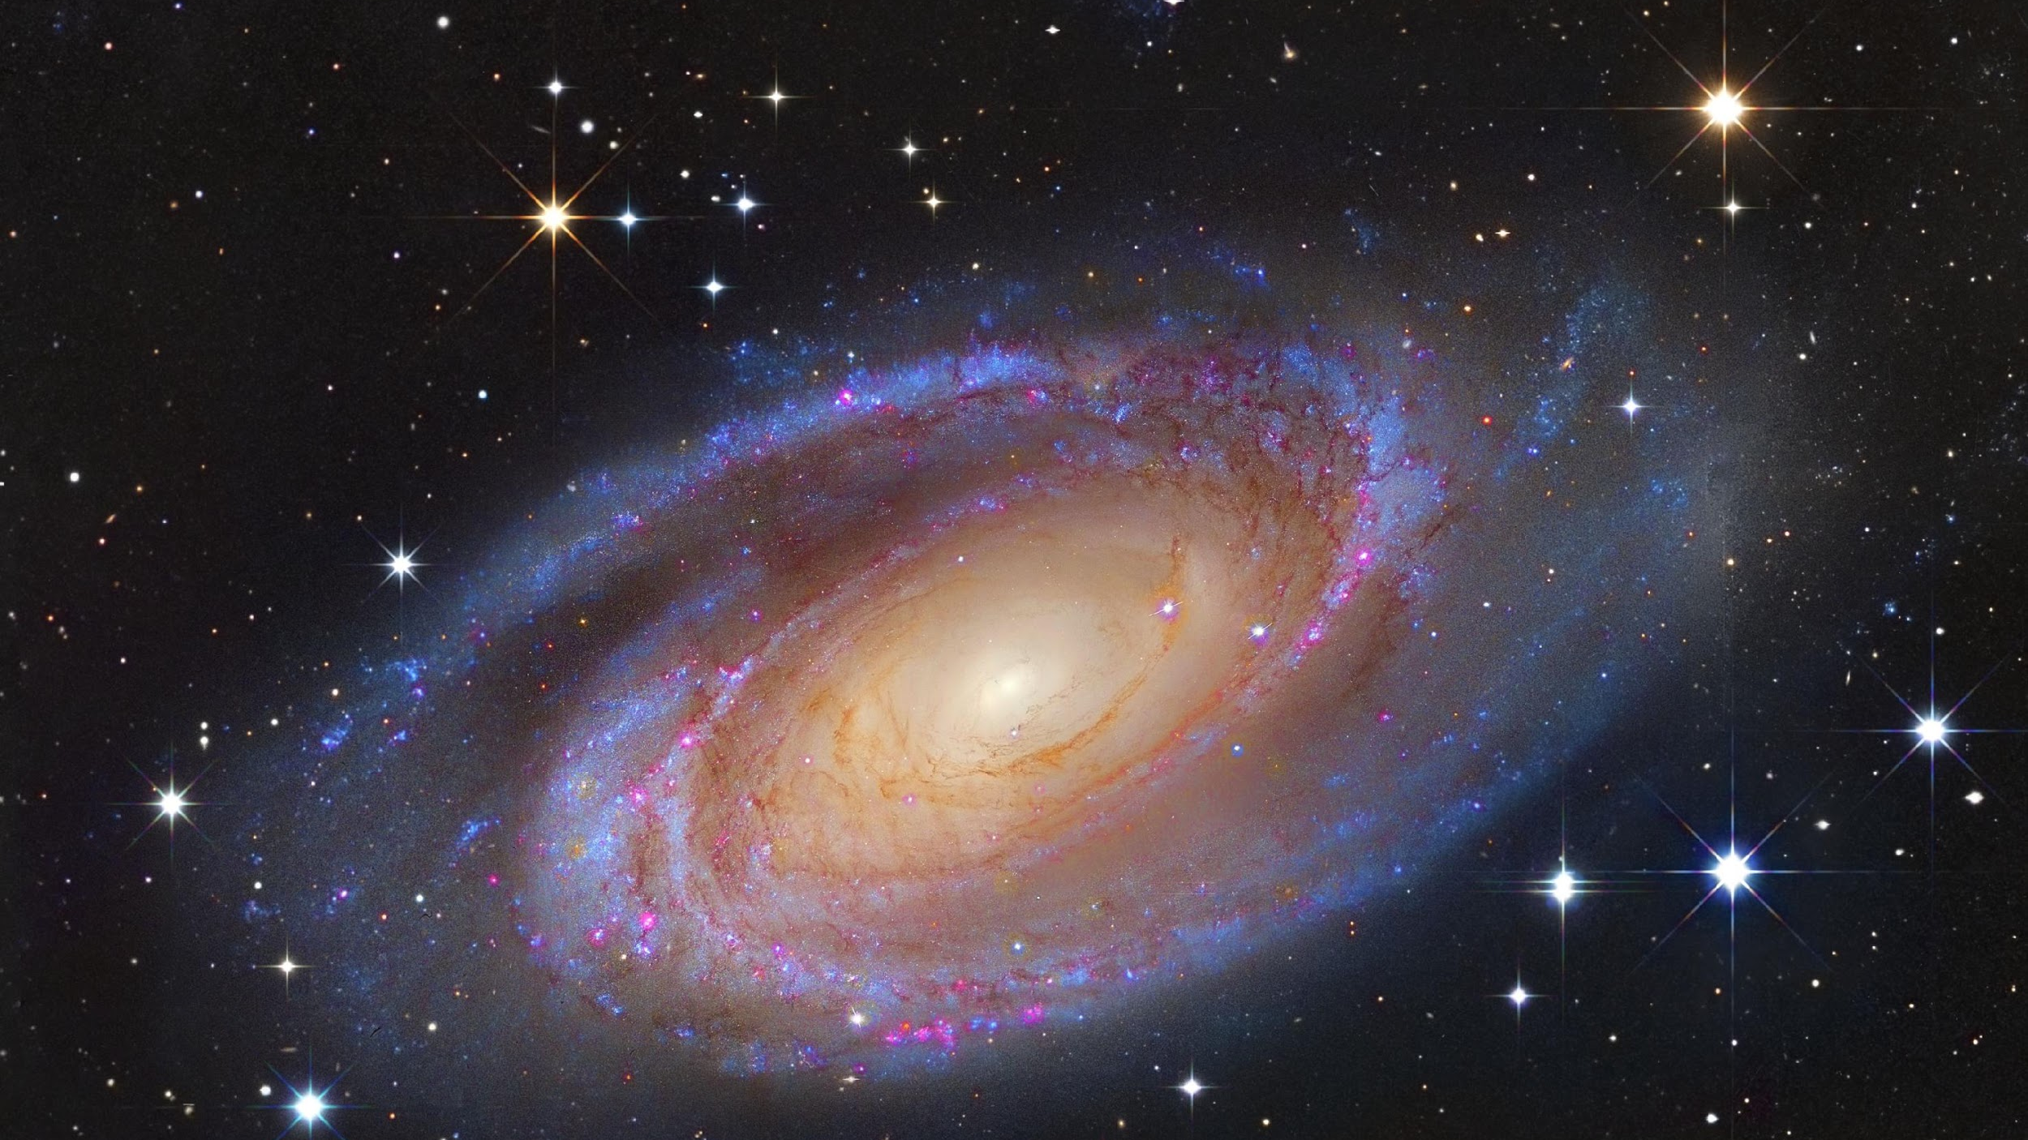
National Science Olympiad
Astronomy 2019 (Division C)
Stellar Evolution in Normal & Starburst Galaxies
Notes:
https://apod.nasa.gov/apod/ap170917.html

Slide 2
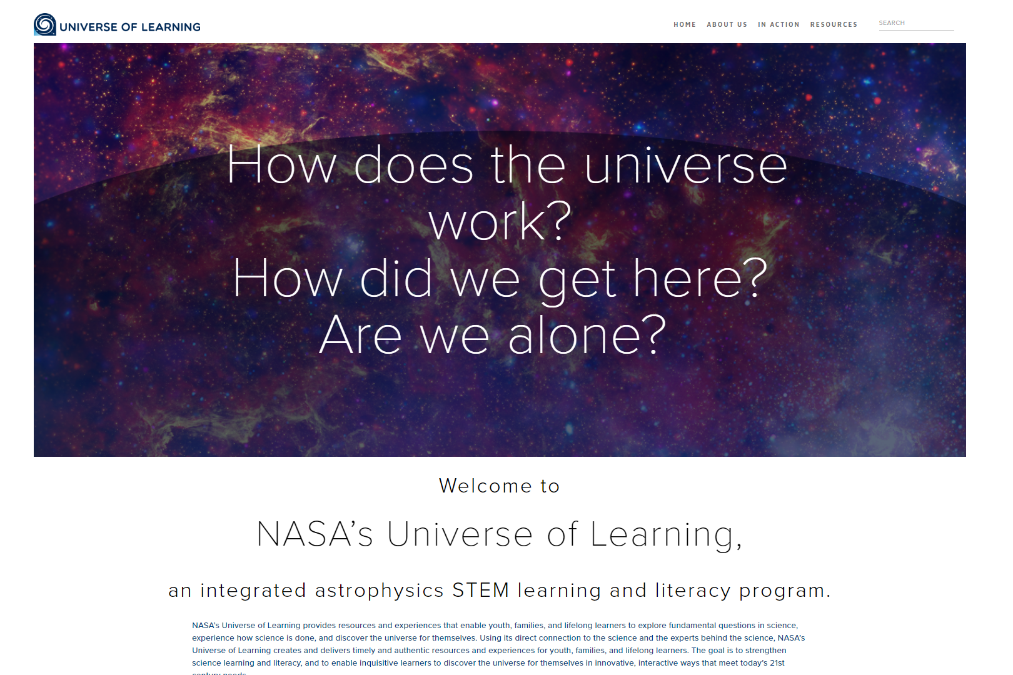
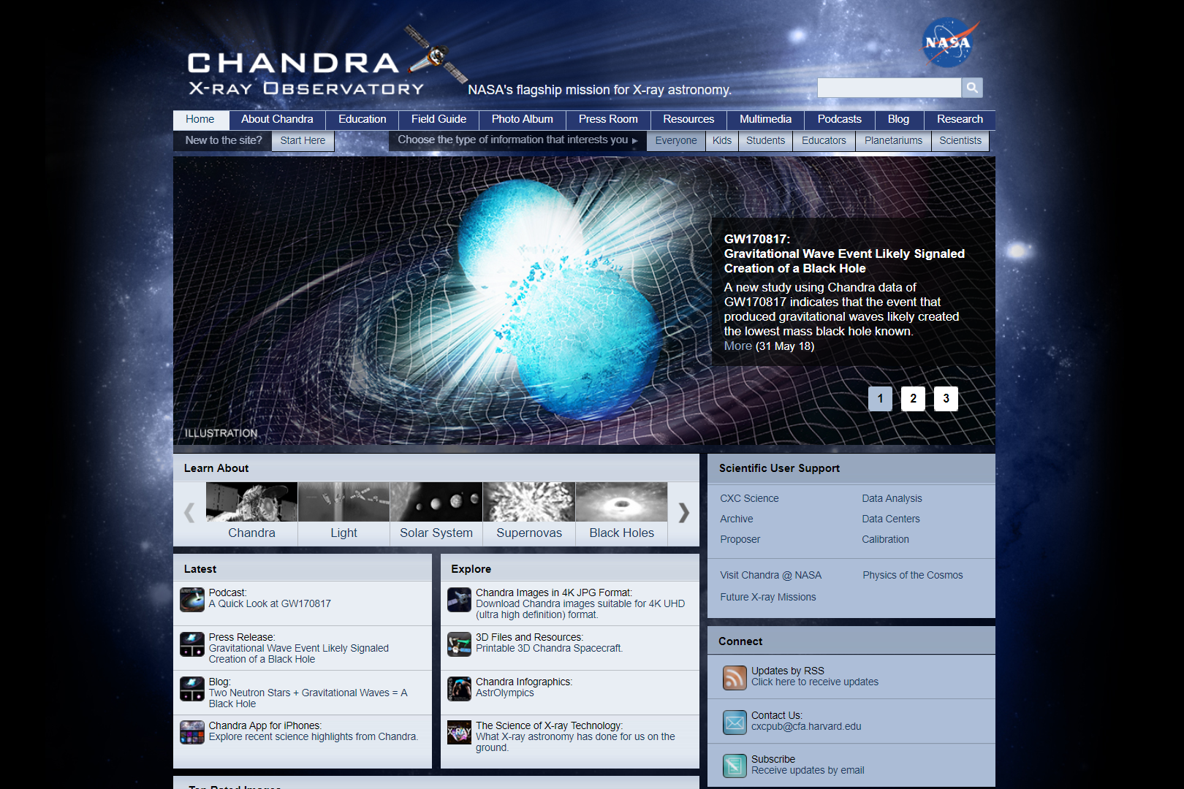
NASA Universe of Learning/CXC/NSO
https://www.universe-of-learning.org/
http://chandra.harvard.edu/index.html
Notes:
https://www.universe-of-learning.org/
http://chandra.harvard.edu/index.html

Slide 3
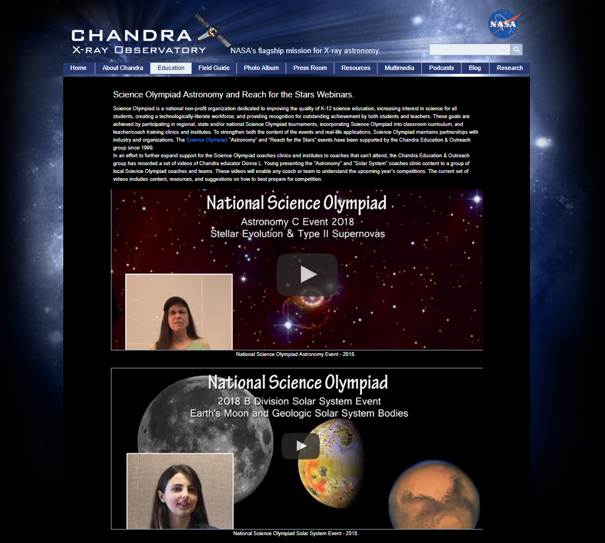
Chandra X-Ray Observatory
http://chandra.harvard.edu/edu/olympiad.html
Notes:
http://chandra.harvard.edu/edu/olympiad.html

Slide 4
2019 Rules
1. DESCRIPTION: Teams will demonstrate an understanding of stellar evolution in normal & starburst galaxies.
A TEAM OF UP TO: 2 APPROXIMATE TIME: 50 minutes
2. EVENT PARAMETERS: Each team is permitted to bring two computers (of any kind) or two 3-ring binders (any size) containing information in any form from any source, or one binder and one computer. The materials must be inserted into the rings (notebook sleeves are permitted). Each team member is permitted to bring a programmable calculator. No internet access is allowed; however teams may access a dedicated NASA data base.

Slide 5
2019 Rules
3. THE COMPETITION: Using information which may include Hertzsprung-Russell diagrams, spectra, light curves, motions, cosmological distance equations and relationships, stellar magnitudes and classification, multi-wavelength images (X-ray, UV, optical, IR, radio), charts, graphs, and JS9 imaging analysis software, teams will complete activities and answer questions related to:
Stellar evolution, including stellar classification, spectral features and chemical composition, luminosity, blackbody radiation, color index and H-R diagram transitions, star formation, Cepheids, RR Lyrae stars, Type Ia & Type II supernovas, neutron stars, pulsars, stellar mass black holes, supermassive black holes, X-ray & gamma-ray binary systems, ultraluminous X-ray sources (ULXs), globular clusters, stellar populations in normal & starburst galaxies, galactic structure and interactions, and gravitational waves.

Slide 6
2019 Rules
3. THE COMPETITION: Using information which may include Hertzsprung-Russell diagrams, spectra, light curves, motions, cosmological distance equations and relationships, stellar magnitudes and classification, multi-wavelength images (X-ray, UV, optical, IR, radio), charts, graphs, and JS9 imaging analysis software, teams will complete activities and answer questions related to:
Use Kepler’s laws, rotation and circular motion to answer questions relating to the orbital motions of binary systems and galaxies; use parallax, spectroscopic parallax, the distance modulus, the period-luminosity relationship, Hubble’s law, and the Tully-Fisher relationship to calculate distances.

Slide 7
2019 Rules
3. THE COMPETITION: Using information which may include Hertzsprung-Russell diagrams, spectra, light curves, motions, cosmological distance equations and relationships, stellar magnitudes and classification, multi-wavelength images (X-ray, UV, optical, IR, radio), charts, graphs, and JS9 imaging analysis software, teams will complete activities and answer questions related to:
Identify and answer questions relating to the content areas outlined above for the following objects: M51/NGC 5195, IC 10, SPT 0346-52, M81/M82, ESO 137-001, SN2014J, Phoenix Cluster, NGC 4993, 47 Tucanae/X9, Chandra Deep Field South, Cen A, M100, Abell 400, Antennae Galaxies, Sagittarius A*

Slide 8
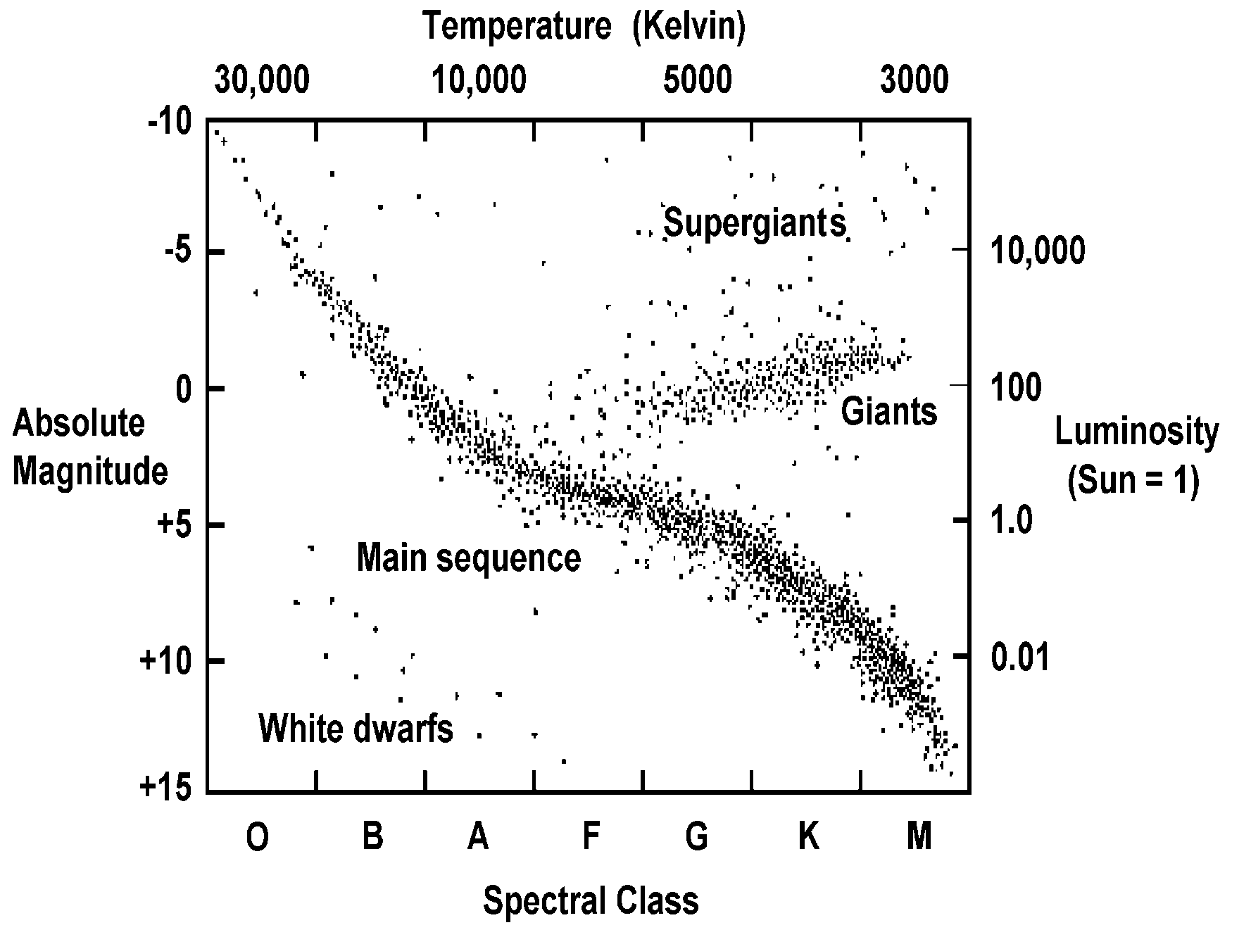
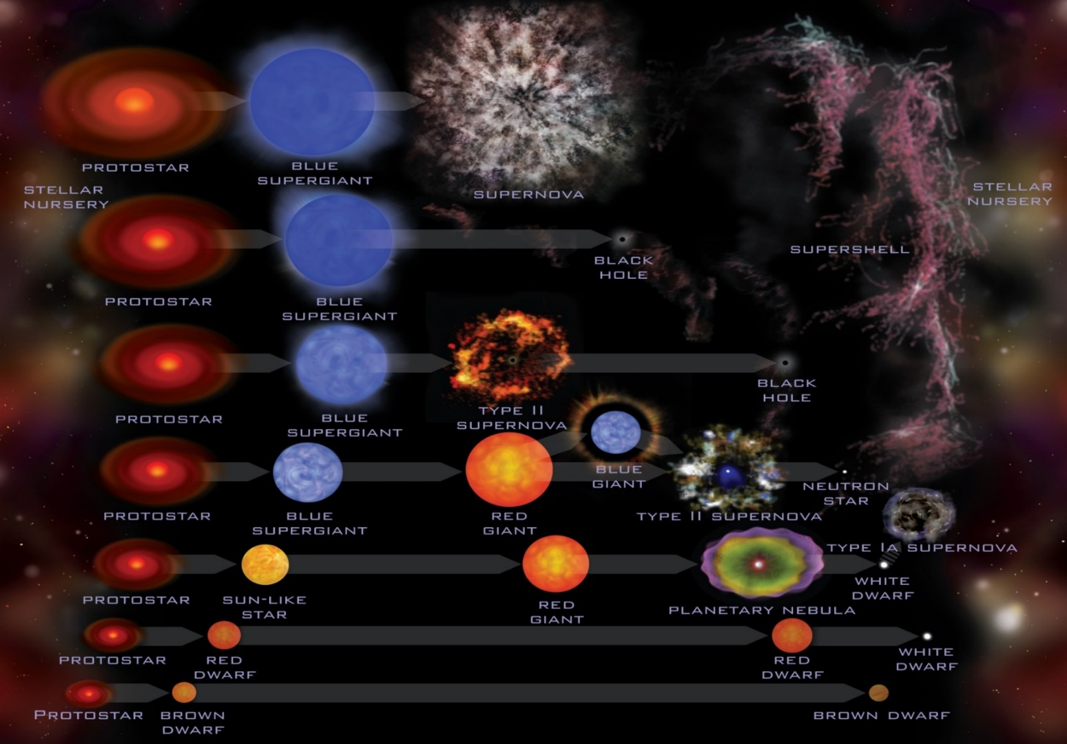
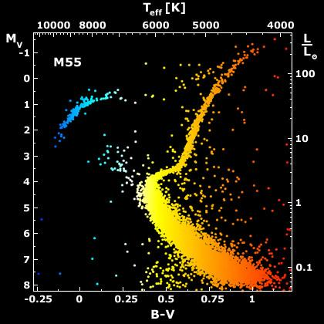
Stellar Evolution…
Notes:
http://chandra.harvard.edu/edu/formal/stellar_ev/story/index3.html
http://chandra.harvard.edu/edu/formal/stellar_ev/story/index4.html

Slide 9
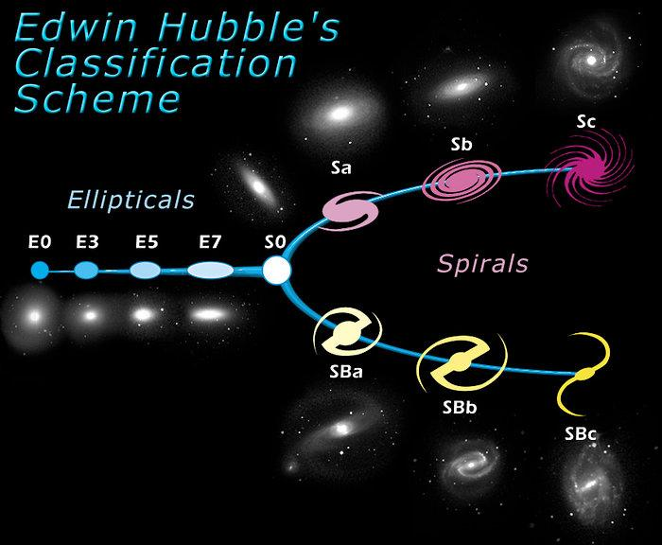
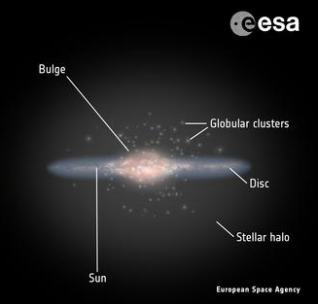
…in Galaxies
Notes:
https://www.spacetelescope.org/images/heic9902o/
http://sci.esa.int/gaia/58206-anatomy-of-the-milky-way/

Slide 10
Deep Sky Objects
Interacting Galaxies:
> Antennae Galaxies
> M51/NGC 5195
> M81/M82
> ESO 137-001
Starburst Galaxies:
> IC 10
> M100
> Cen A
> Phoenix Cluster
> SPT 0346-52
Compact Objects (and their explosions):
> SN2014J
> NGC 4993
> 47 Tucanae/X9
Supermassive Black Holes (SMBHs):
> Sagittarius A*
> Abell 400
> Chandra Deep Field South

Slide 11
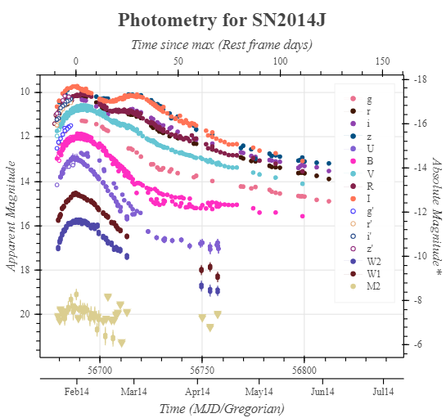
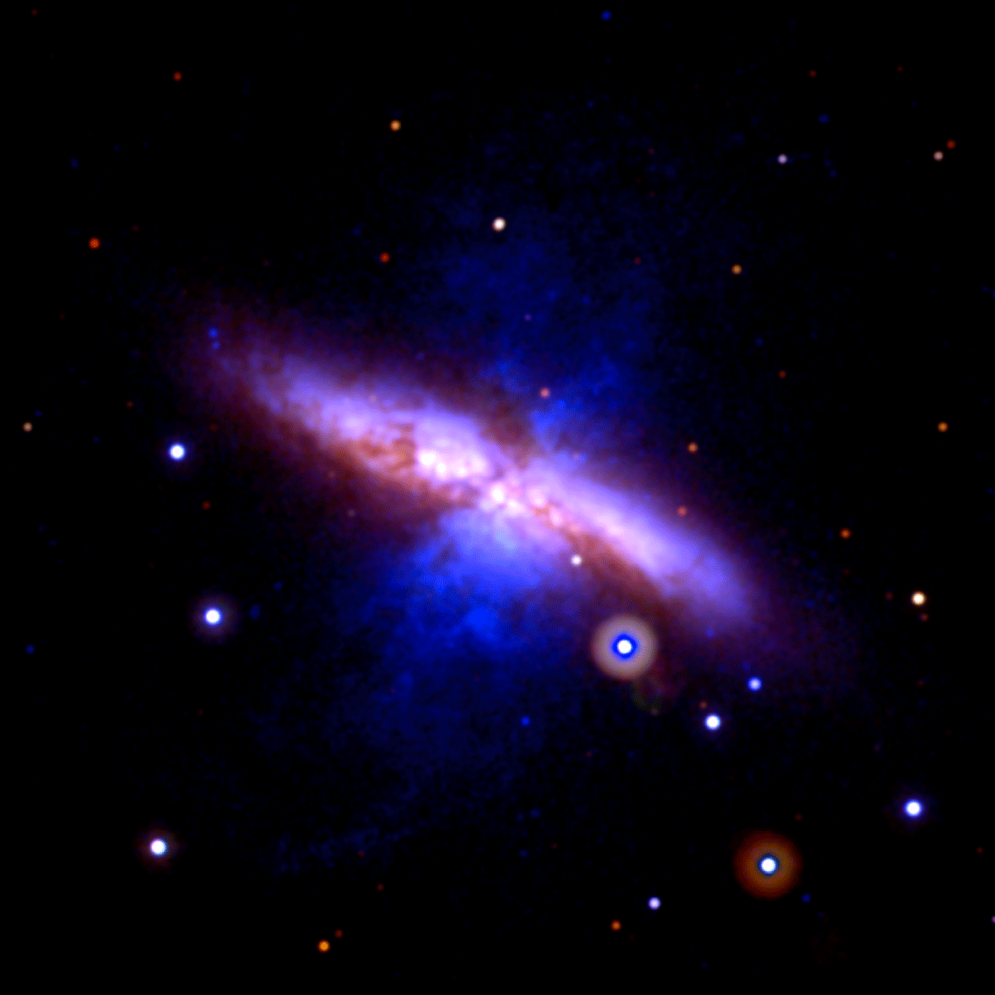
SN2014J
Type Ia SN in M82
  Closest in 40+ years
Unusual variations in the “standard candle”
  Fast rise to maximum brightness
  Little nearby material for blast to collide with
Notes:
https://svs.gsfc.nasa.gov/11459
https://www.nasa.gov/chandra/multimedia/supernova-sn2014j.html
https://sne.space/sne/SN2014J/

Slide 12
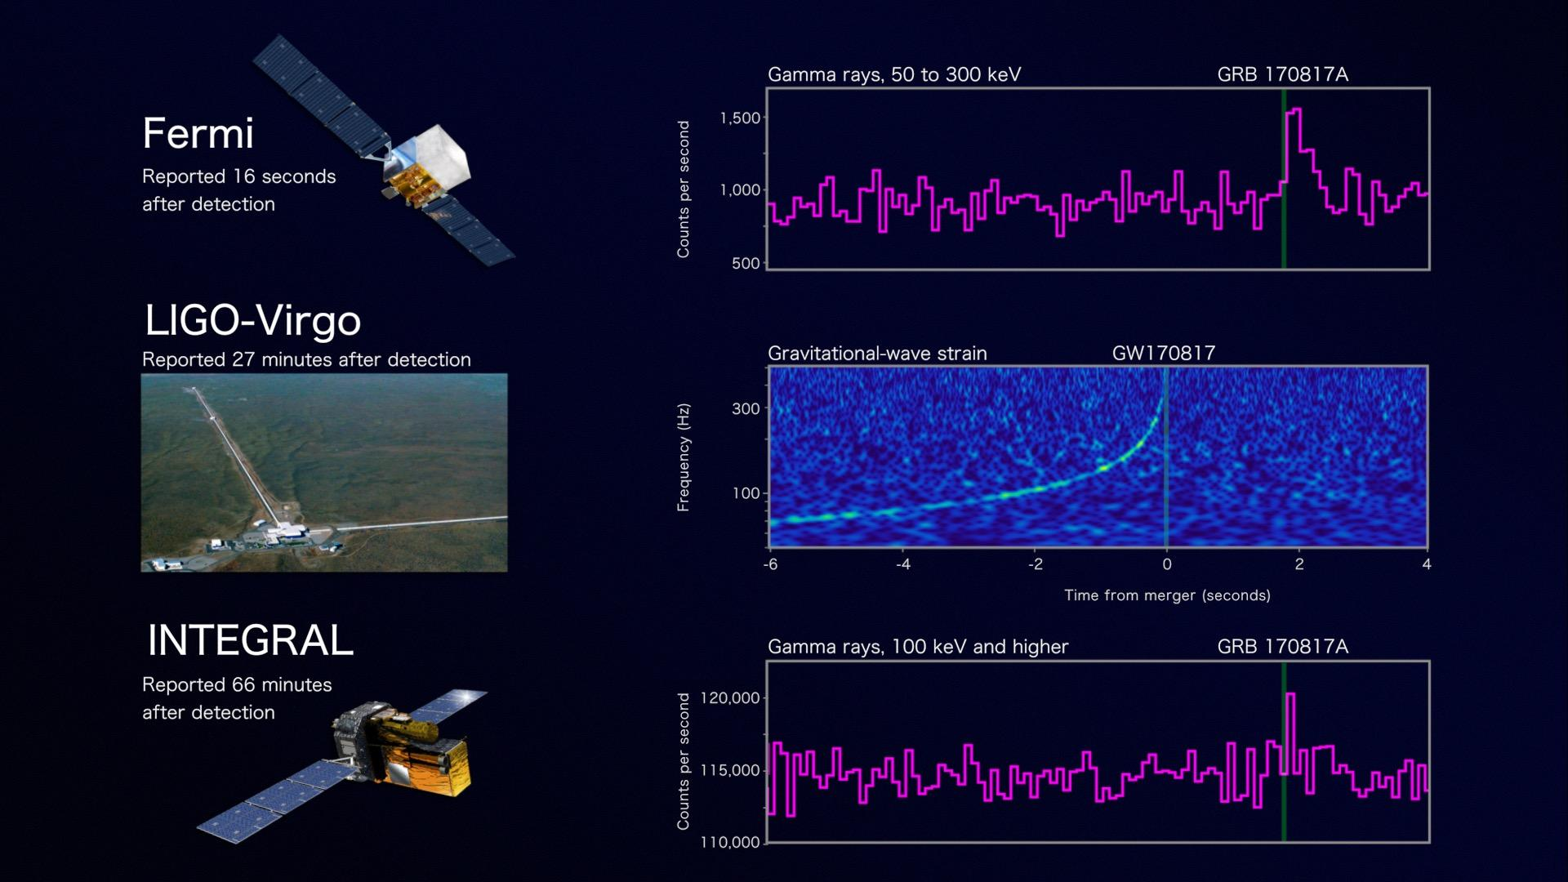
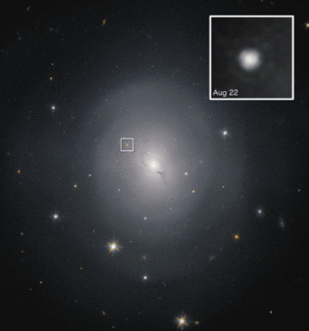
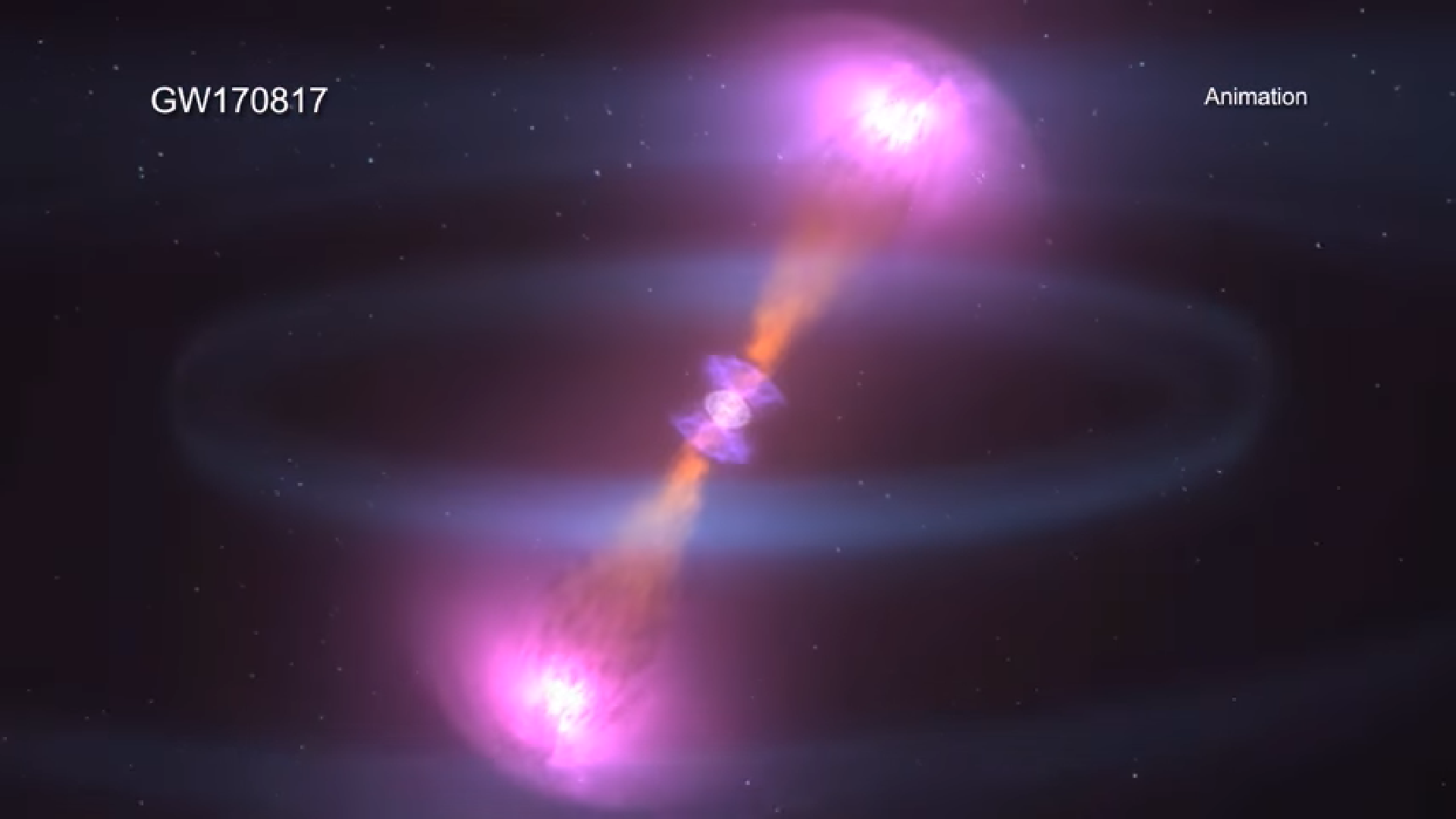
NGC 4993
Elliptical/lenticular galaxy
Host galaxy of GW170817
  Kilonova (merger of binary neutron stars)
  “Multi-messenger” event observed through both gravitational waves & many EM wavelengths
Notes:
https://www.nasa.gov/press-release/nasa-missions-catch-first-light-from-a-gravitational-wave-event
https://www.nasa.gov/feature/goddard/2017/nasa-s-hubble-studies-source-of-gravitational-waves
https://www.youtube.com/watch?v=txpIT0PW02E
https://www.cosmos.esa.int/web/integral/pom-generation?p_p_id=48_INSTANCE_cPRGXJw9FQjM&_48_INSTANCE_cPRGXJw9FQjM_iframe_yr=2017&_48_INSTANCE_cPRGXJw9FQjM_iframe_mon=11&_48_INSTANCE_cPRGXJw9FQjM_iframe_extn=jpg

Slide 13
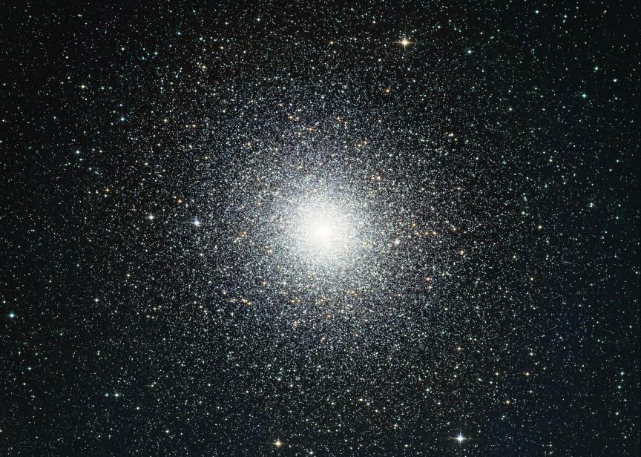
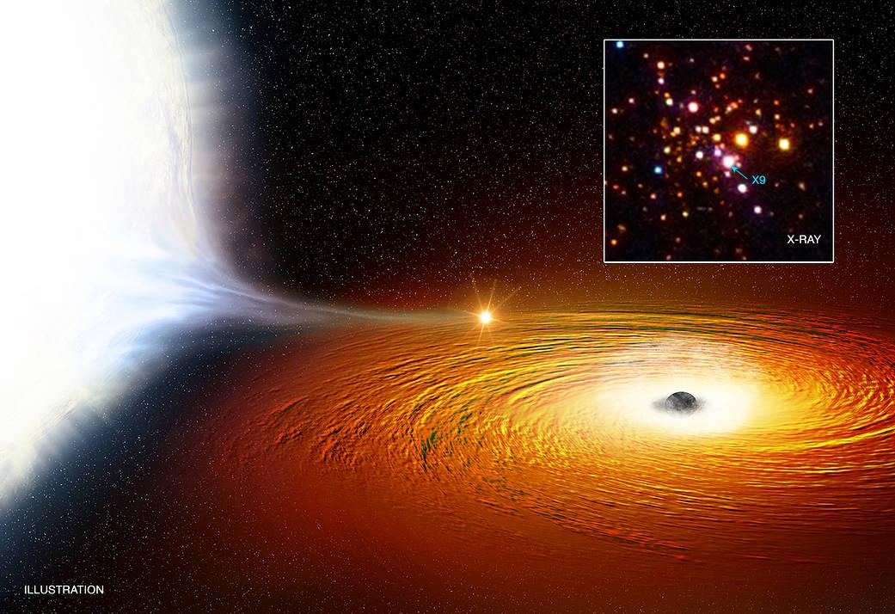
47 Tucanae / X9
Massive globular cluster
  Primarily old, low mass stars
  Many X-ray sources in core
X9 is a Low Mass X-ray Binary
  Stellar mass black hole pulling material from white dwarf
  Very close orbit – period 28 min (!)
Notes:
https://apod.nasa.gov/apod/ap110116.html
https://apod.nasa.gov/apod/ap050721.html
https://www.nasa.gov/mission_pages/chandra/images/artist-s-impression-of-47-tucanae-x9.html

Slide 14
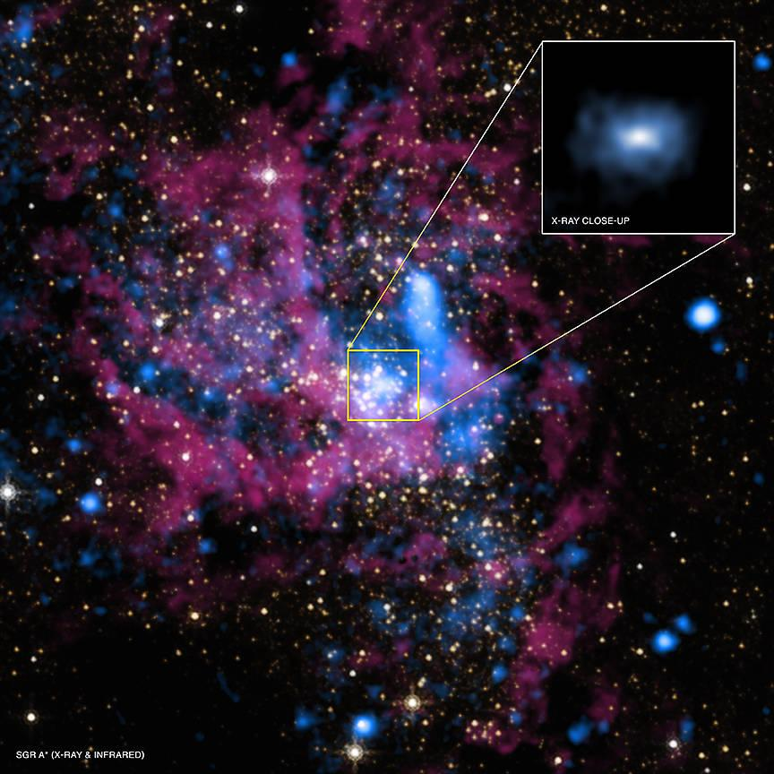
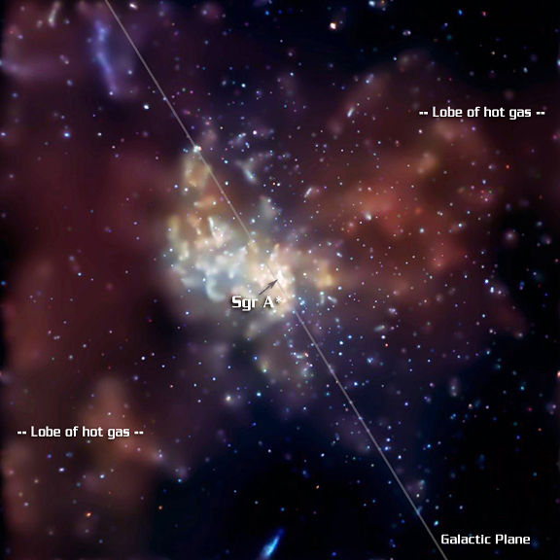
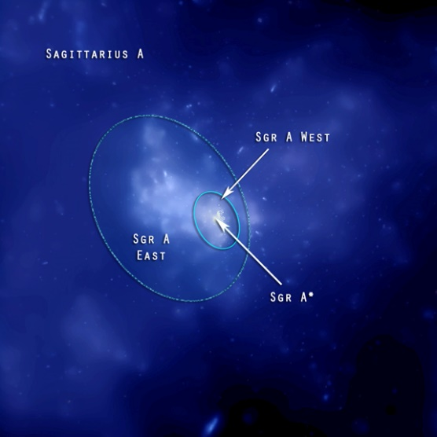
Sagittarius A*
Radio source corresponding to Milky Way’s SMBH
  Difficult to see in visible light due to extinction
A typical (?) quiet SMBH
  Mass determined by orbits of nearby stars
  Most material ends up ejected, not consumed
  Flares and past outbursts
Notes:
https://www.nasa.gov/mission_pages/chandra/multimedia/black-hole-SagittariusA.html
https://www.e-education.psu.edu/astro801/content/l8_p7.html
https://phys.org/news/2018-05-sagittarius-swarm-black-hole-bounty.html
http://chandra.harvard.edu/photo/2015/sgra2/

Slide 15
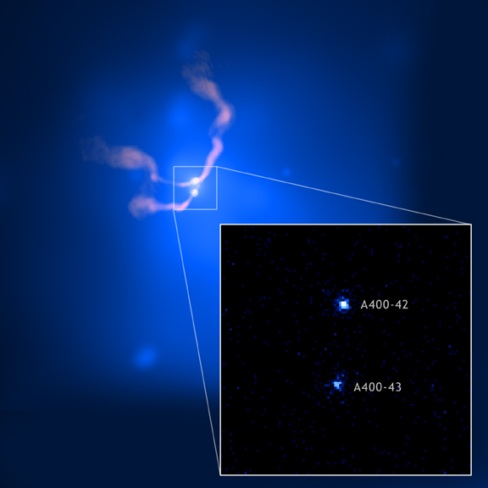
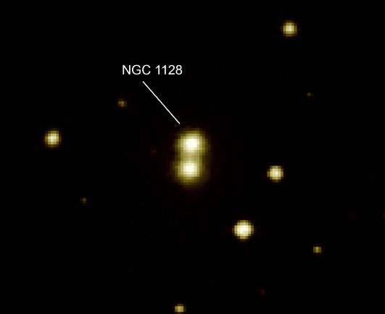
Abell 400
Galaxy cluster
  Diffuse, super-hot intergalactic gas throughout
“Dumbbell” galaxy NGC 1128 (2 merging galaxies)
  SMBHs will eventually merge too
  Radio jets (source 3C 75) show common motion
Notes:
http://chandra.harvard.edu/photo/2006/a400/more.html
https://apod.nasa.gov/apod/ap100314.html
http://images.nrao.edu/30

Slide 16
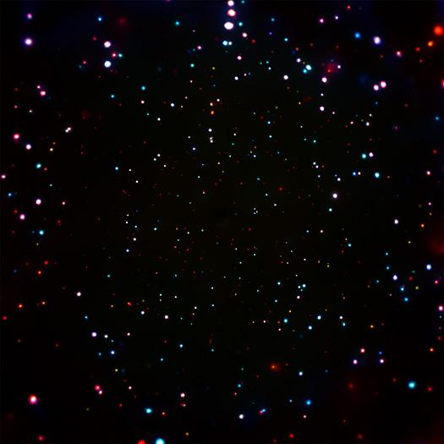
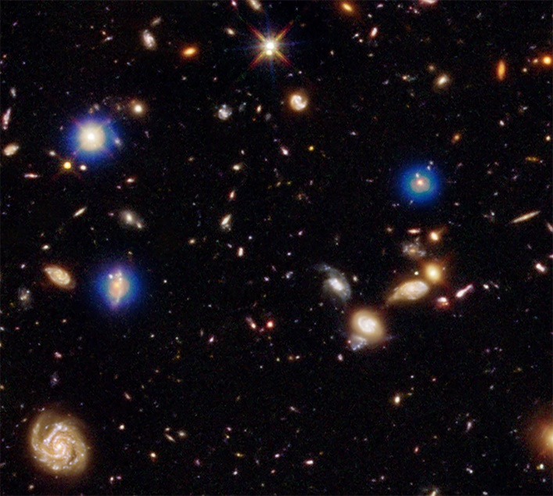
Chandra Deep Field South
Deep imaging to study early X-ray universe
  7,000,000+ seconds of observing time
Formation and growth of young SMBHs
  May not grow in sync with their galaxies
X-ray transient – GRB?
Notes:
http://chandra.harvard.edu/press/17_releases/press_010517cdfs.html
https://www.nasa.gov/mission_pages/chandra/news/supermassive-black-holes-are-outgrowing-their-galaxies.html
http://chandra.harvard.edu/photo/2017/cdfsxt1/

Slide 17
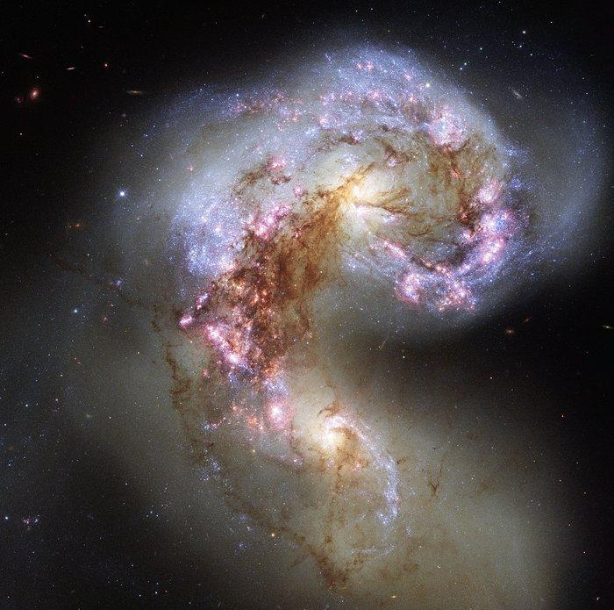
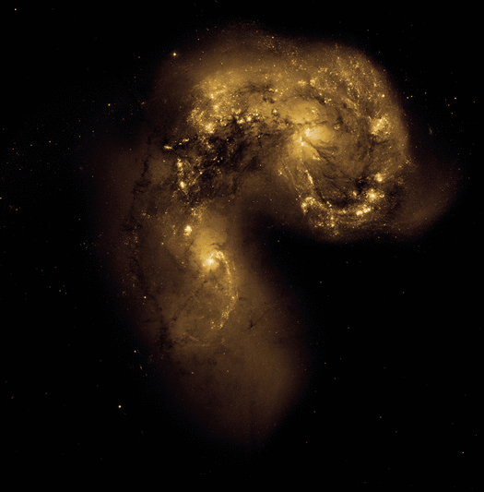
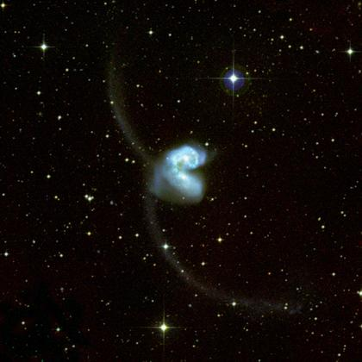
Antennae Galaxies
Galaxies in the middle of colliding
  Used to be spirals
  Compression of gas causes star formation
Long tidal tails
  Stars flung outwards by gravitational interactions
Notes:
https://www.spacetelescope.org/images/potw1345a/
https://apod.nasa.gov/apod/ap120812.html
http://chandra.harvard.edu/photo/2010/antennae/

Slide 18
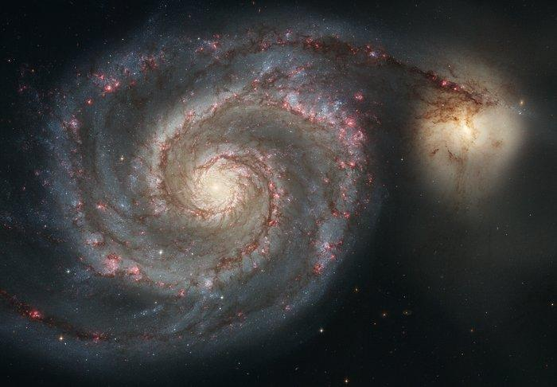
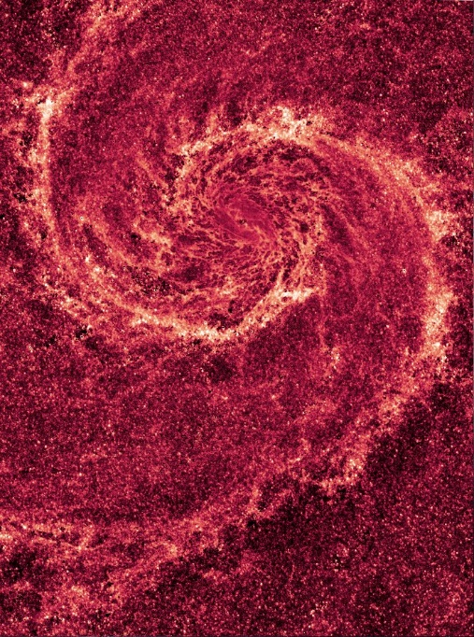
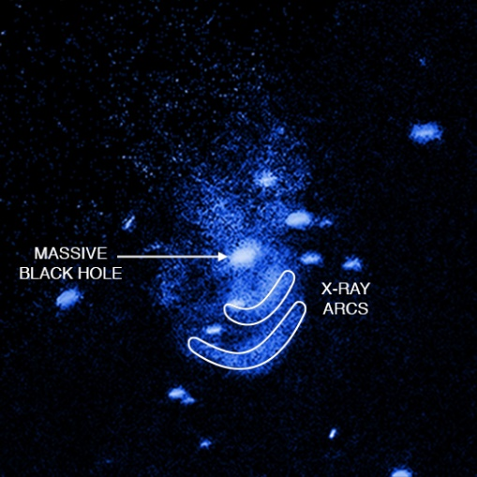
M51 / NGC 5195
Grand design spiral + irregular dwarf galaxy
Not colliding, just passing
  Gravitational interaction triggers star formation in spiral arms
“Feedback” in NGC 5195
  Hot gas from SMBH sweeps up cooler gas
Notes:
https://www.spacetelescope.org/images/heic0506a/
https://apod.nasa.gov/apod/ap110126.html
http://chandra.harvard.edu/photo/2016/ngc5195/
http://coolcosmos.ipac.caltech.edu/cosmic_classroom/multiwavelength_astronomy/multiwavelength_museum/m51.html

Slide 19
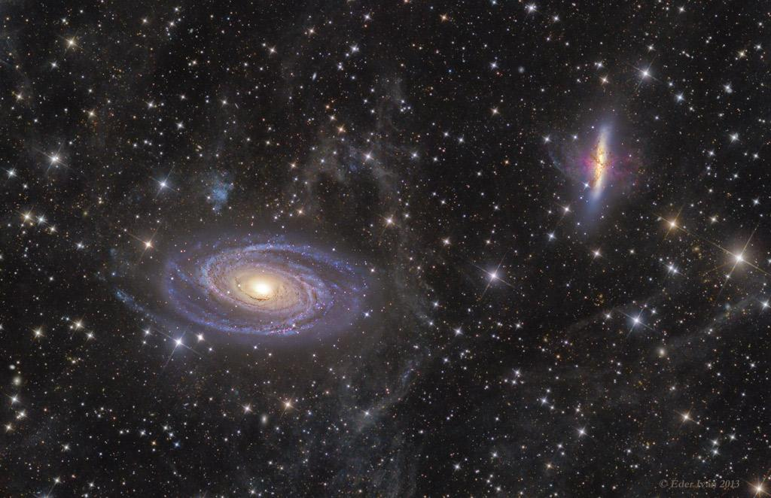
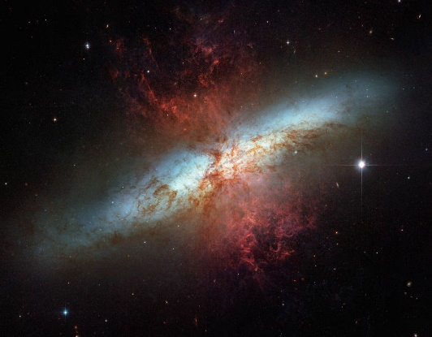
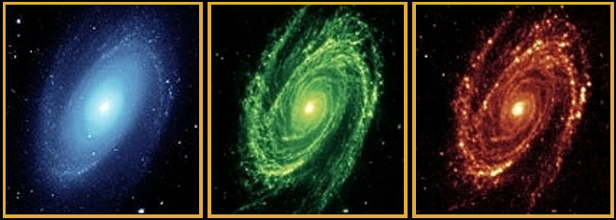
M81 / M82
2 spiral galaxies
  M82 much more distorted
Starburst in core of M82
  Galactic “superwind” from combined stellar winds
Some star formation in spiral arms of M81, but not central bulge
Notes:
https://apod.nasa.gov/apod/ap130925.html
http://coolcosmos.ipac.caltech.edu/cosmic_classroom/multiwavelength_astronomy/multiwavelength_museum/m81.html
https://www.nasa.gov/feature/goddard/2017/messier-82-the-cigar-galaxy

Slide 20
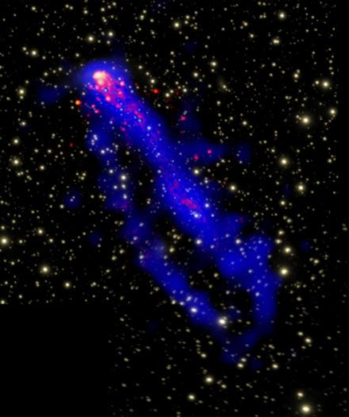
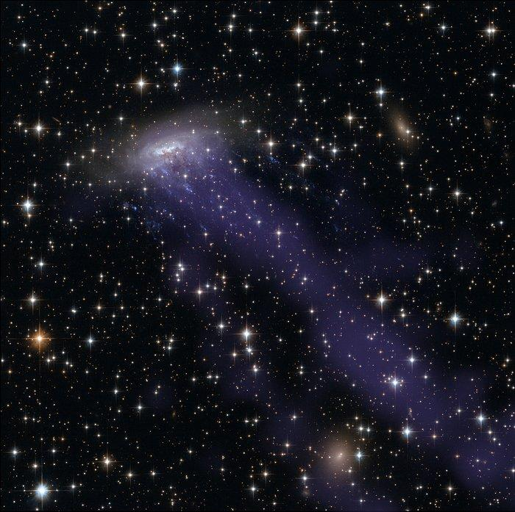
ESO 137-001
Spiral galaxy in cluster Abell 3627
Trails of gas and young stars
  Ram pressure stripping (drag force from intergalactic gas)
  No gas left for future star formation
Notes:
https://apod.nasa.gov/apod/ap150801.htm
https://www.spacetelescope.org/news/heic1404/
http://chandra.harvard.edu/photo/2010/eso137/

Slide 21
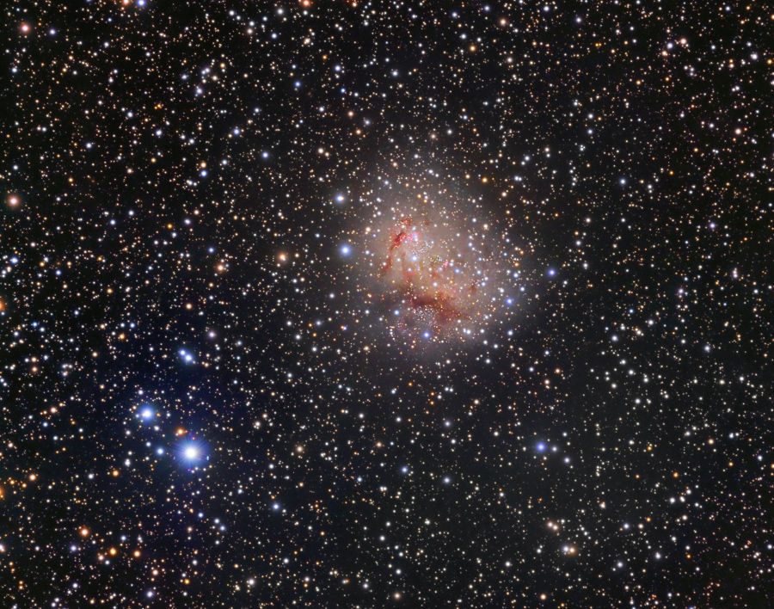
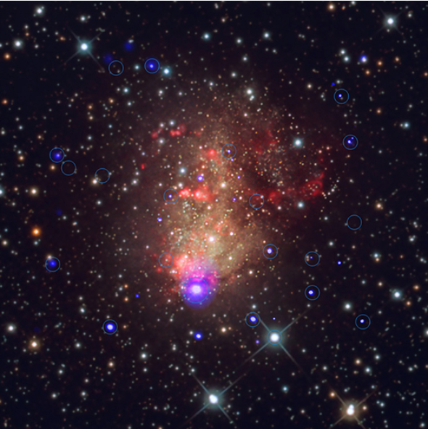
IC 10
Irregular dwarf galaxy
Only starburst galaxy in the Local Group
  Distance = 2.3 million ly
Many X-ray binaries
  Starburst means lots of young, massive stars exist
Notes:
http://chandra.harvard.edu/photo/2017/ic10/
http://annesastronomynews.com/photo-gallery-ii/galaxies-clusters/ic-10/
https://apod.nasa.gov/apod/ap120104.html

Slide 22
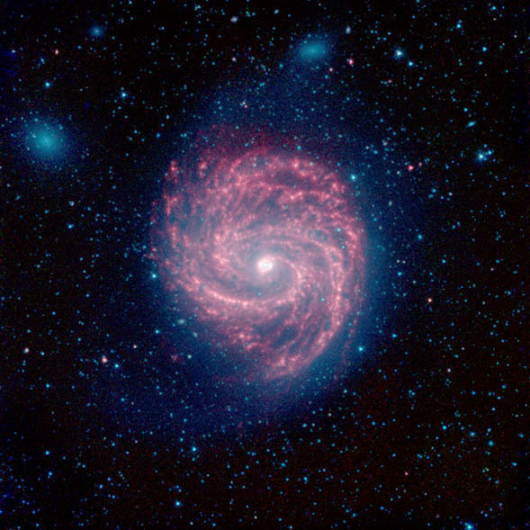
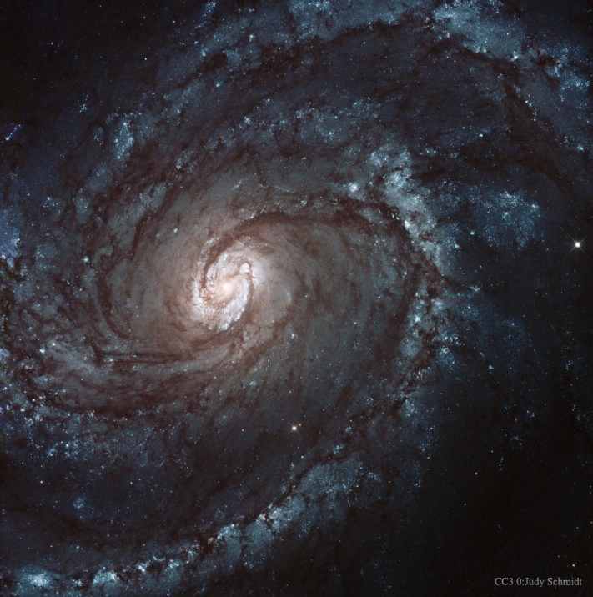
M100
Grand design spiral
  2 small companion galaxies
Starburst strongest near core
  Disk deficient in H because gas is stripped away
Distance determined by Cepheids and supernovae
Notes:
http://www.messier-objects.com/messier-100/
https://apod.nasa.gov/rjn/apod/ap150211.html
https://apod.nasa.gov/apod/ap060307.html
http://coolcosmos.ipac.caltech.edu/cosmic_classroom/multiwavelength_astronomy/multiwavelength_museum/m100.html

Slide 23
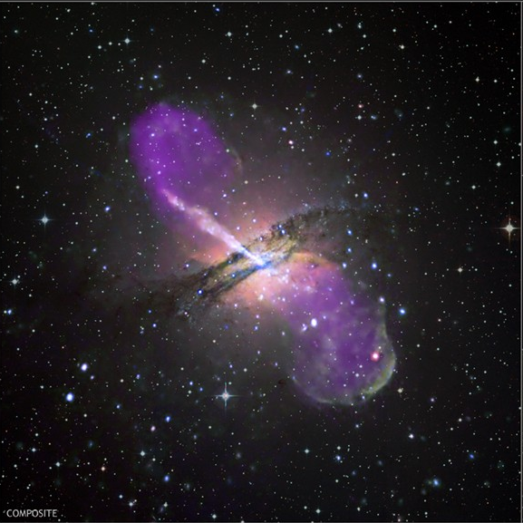
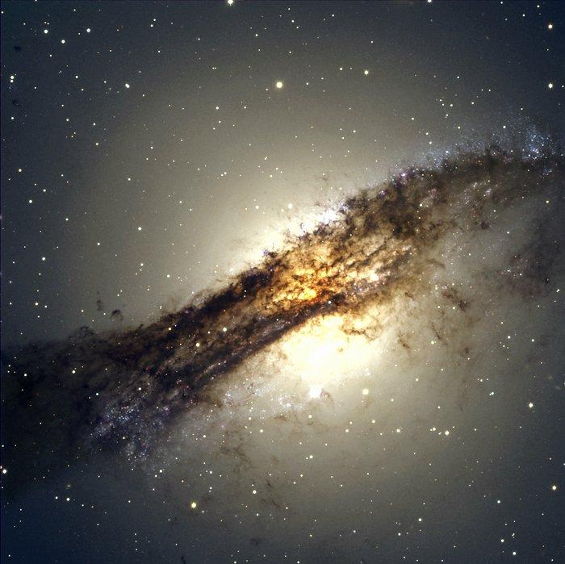
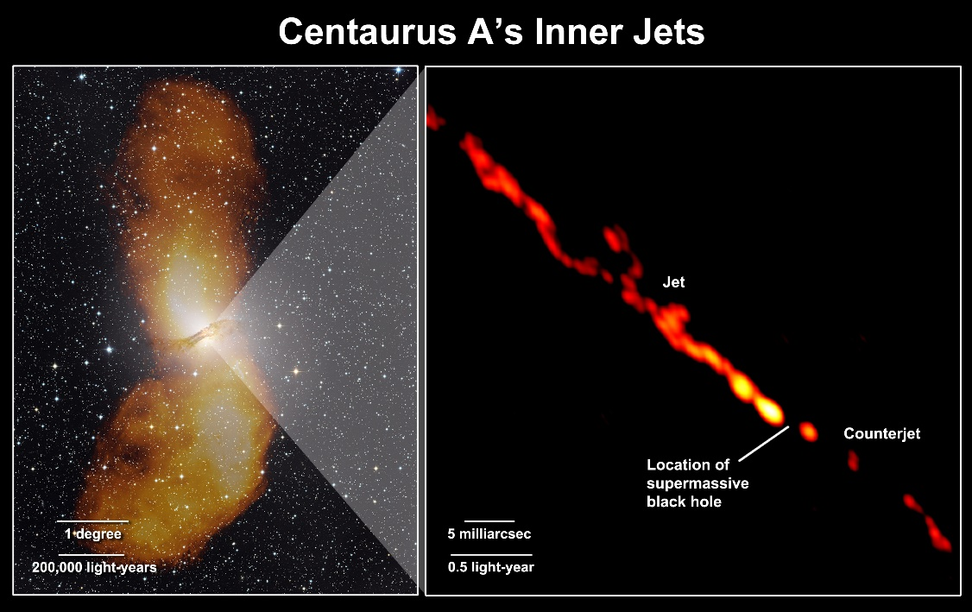
Cen A
Starburst elliptical galaxy
  Ellipticals shouldn’t be forming many stars
  Probably ate a small spiral
Radio jets (AGN)
  Huge amounts of energy being ejected
  Link between starburst and AGN activity?
Notes:
https://www.eso.org/public/images/eso0005b/
https://apod.nasa.gov/apod/ap080110.html
https://www.nasa.gov/topics/universe/features/radio-particle-jets.html
http://www.solstation.com/x-objects/cent-a.htm

Slide 24
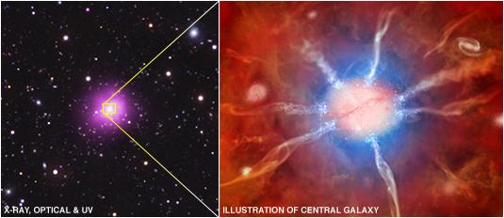
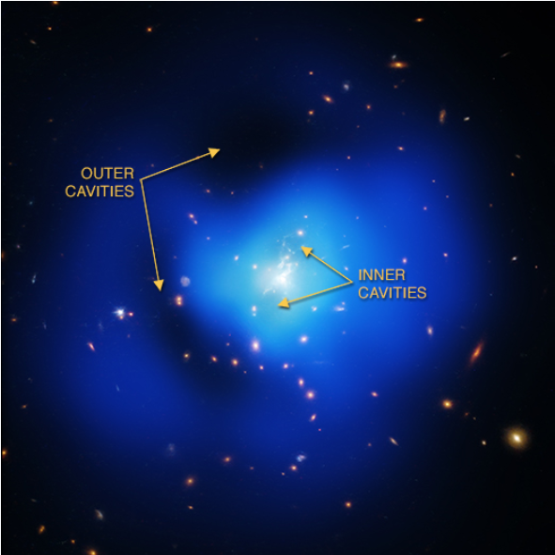
Phoenix Cluster
Massive galaxy cluster with lots of X-ray emission
Central galaxy has extremely high star formation rates AND a growing SMBH
  AGN jets usually prevent star formation (gas can’t cool)
  Gas is condensing at the edges of cavities
Notes:
http://www.sci-news.com/astronomy/black-hole-phoenix-clusters-central-galaxy-04623.html
http://chandra.harvard.edu/photo/2012/phoenix/

Slide 25
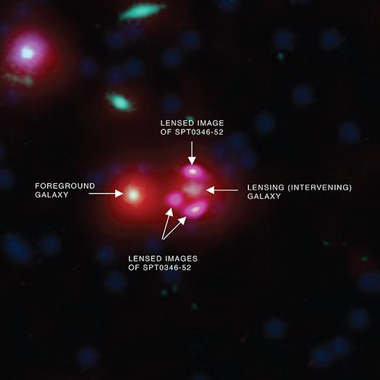
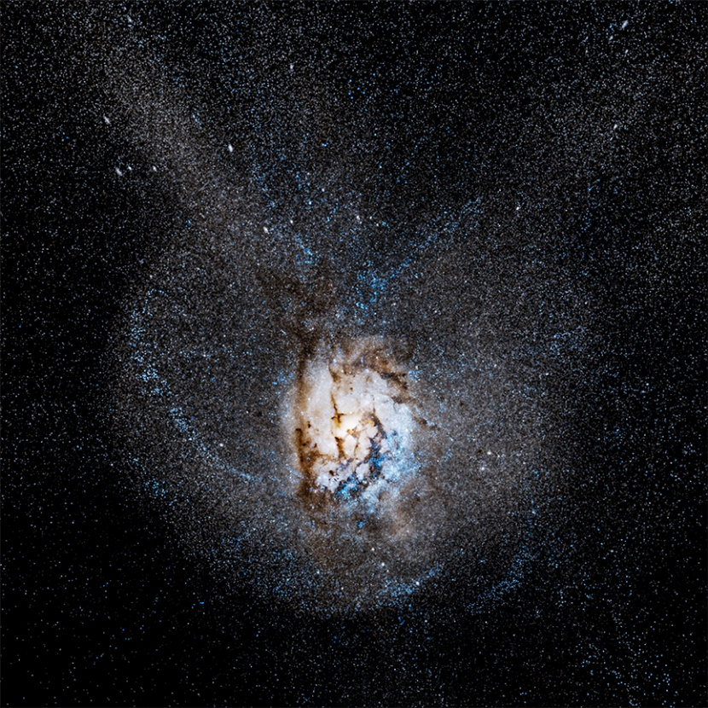
SPT 0346-52
“Hyper-starburst” galaxy 12.7 billion ly away
  Era of early galaxy growth
Infrared excess, but no evidence of growing SMBH
  Extreme star formation (4500 solar masses/year), possibly due to merger
Notes:
http://chandra.harvard.edu/photo/2016/spt0346/
http://www.sci-news.com/astronomy/hyper-starburst-galaxy-04439.html
https://www.youtube.com/watch?v=tqmBHzhLNwE

Slide 26
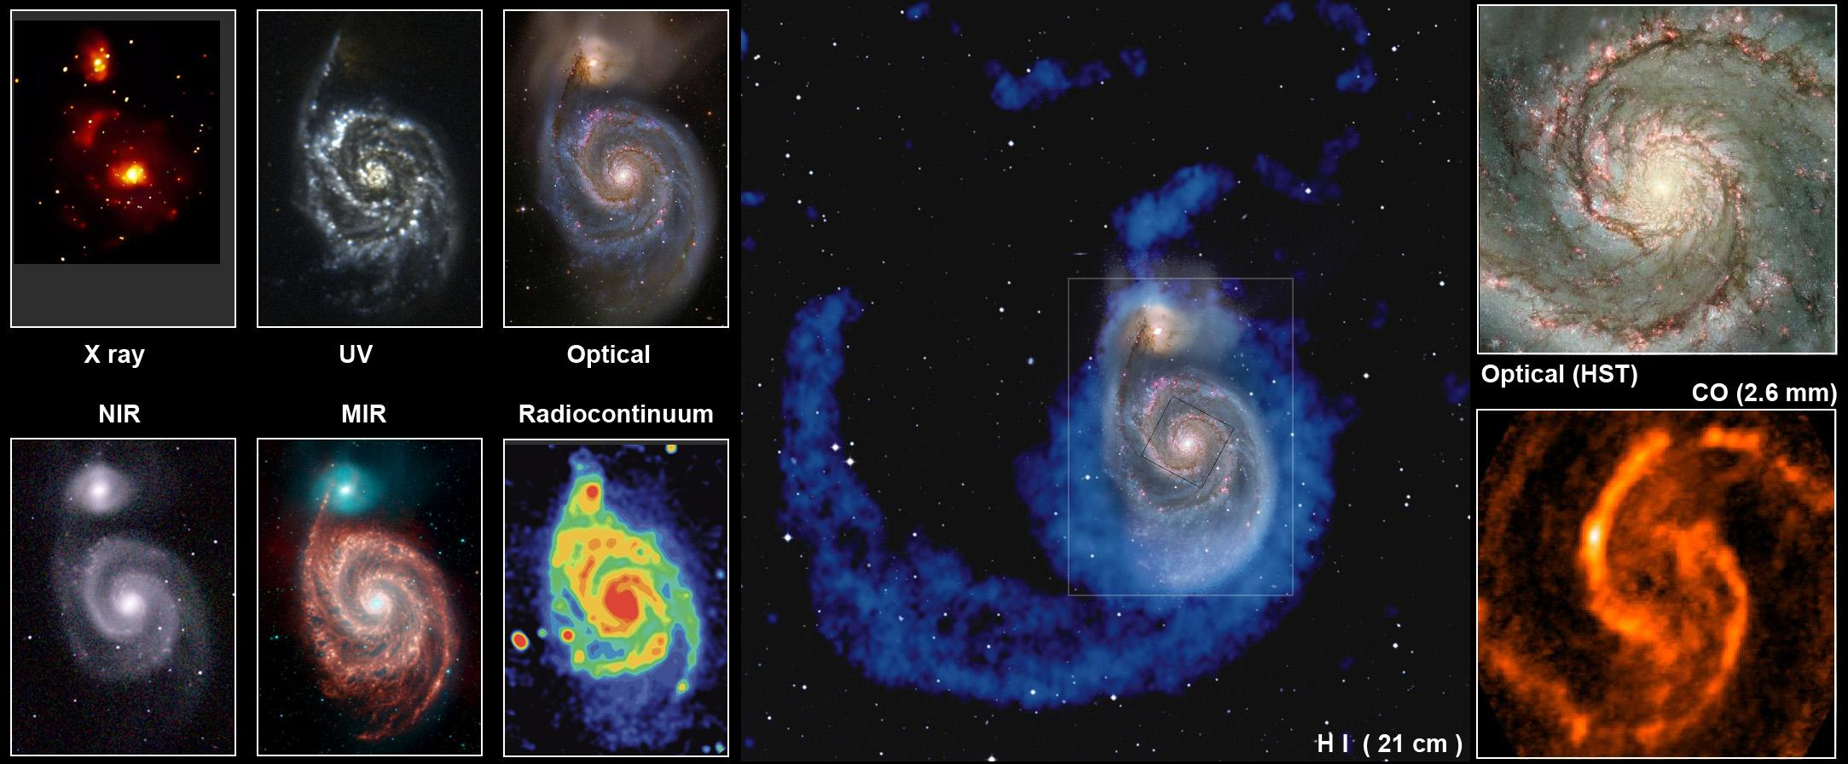
Multiwavelength Observations
Notes:
http://www.atnf.csiro.au/people/lop009/multiwave.html

Slide 27
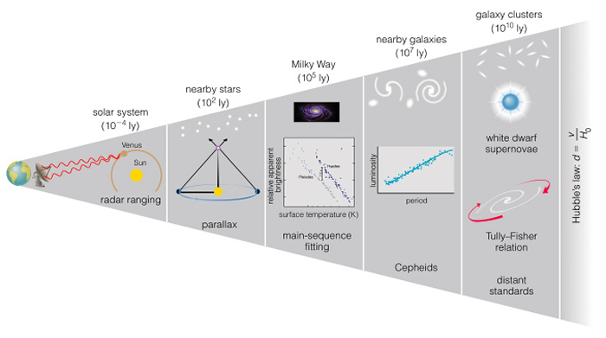
Measuring Distances
Notes:
http://www.daviddarling.info/encyclopedia/C/cosmic_distance_ladder.html

Slide 28
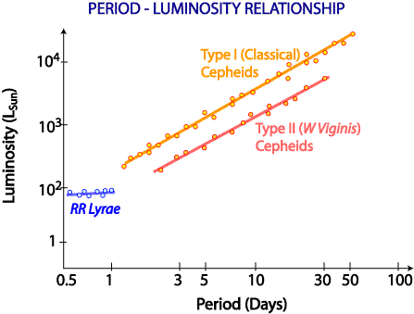
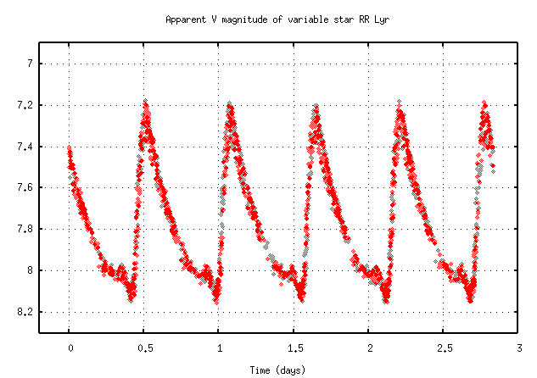
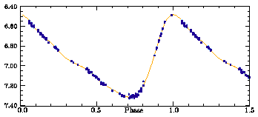
Cepheids & RR Lyrae
Cepheids follow Leavitt Law (Period-Luminosity Relationship)
RR Lyrae are also “standard candles”
  Much shorter periods (~ 1 day)
  Often found in globular clusters
Notes:
http://www.atnf.csiro.au/outreach/education/senior/astrophysics/variable_cepheids.html
http://spiff.rit.edu/classes/phys230/lectures/mw_size/mw_size.html
https://www.ifa.hawaii.edu/users/mendez/ASTRO110LAB11/variables.html

Slide 29



Tully-Fisher Relation & Hubble’s Law
Notes:
http://hyperphysics.phy-astr.gsu.edu/hbase/astro/hubble.html
https://ned.ipac.caltech.edu/level5/Cepheids/Cepheids38.html

Slide 30



Spectra
Notes:
http://spiff.rit.edu/classes/phys230/lectures/spec_interp/spec_interp.html
http://star-www.st-and.ac.uk/~spd3/Teaching/PHYS1002/phys1002_lecture6.pdf
http://www.atnf.csiro.au/outreach/education/senior/astrophysics/spectra_astro_types.html
http://spiff.rit.edu/classes/phys301/lectures/doppler/doppler.html

Slide 31



Radiation Laws
Notes:
http://hyperphysics.phy-astr.gsu.edu/hbase/wien.html
http://jila.colorado.edu/~ajsh/courses/astr1120_03/text/chapter1/SBLaw.htm

Slide 32

Basic Equations & Relationships

Slide 33

Basic Equations & Relationships

Slide 34

JS9
https://js9.si.edu/
Notes:
https://js9.si.edu/

Slide 35
Resources
National Science Olympiad
Chandra (X-ray)
Hubble (visible)
Spitzer (infrared)
National Radio Astronomy Observatory
Astronomy Picture of the Day
http://www.soinc.org
http://chandra.harvard.edu
http://stsci.edu/hst/
http://www.spitzer.caltech.edu
https://public.nrao.edu
http://apod.nasa.gov

Slide 36
Event Information
National Event Supervisors:
Donna L. Young (dlyoung.nso@gmail.com) and Tad Komacek (tkomacek@gmail.com)
Rules Clarifications available at soinc.org under Event Information
Read the Event Description for content and allowable resources.
Use the webinar (Chandra) and/or powerpoint (NSO) for an overview of the content topics and deep sky objects.
Use the Astronomy Coaches Manual (NSO) as a guide for background information.
Use the resources listed in the event description for images and content.

Slide 37
Event Information
National Event Supervisors:
Donna L. Young (dlyoung.nso@gmail.com) and Tad Komacek (tkomacek@gmail.com)
Rules Clarifications available at soinc.org under Event Information.
Youtube has many related videos.
Invitationals.
Tests from invitationals and sample state tests will be posted on the NSO website for teams to use for practice.
The scioly.org test exchange (https://scioly.org/wiki/index.php/2018_Test_Exchange).

